Slide 1
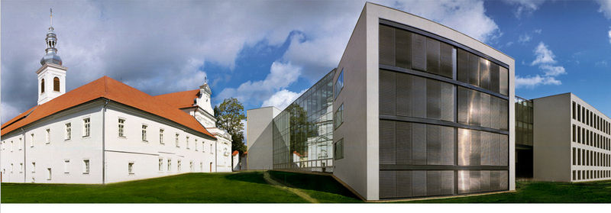

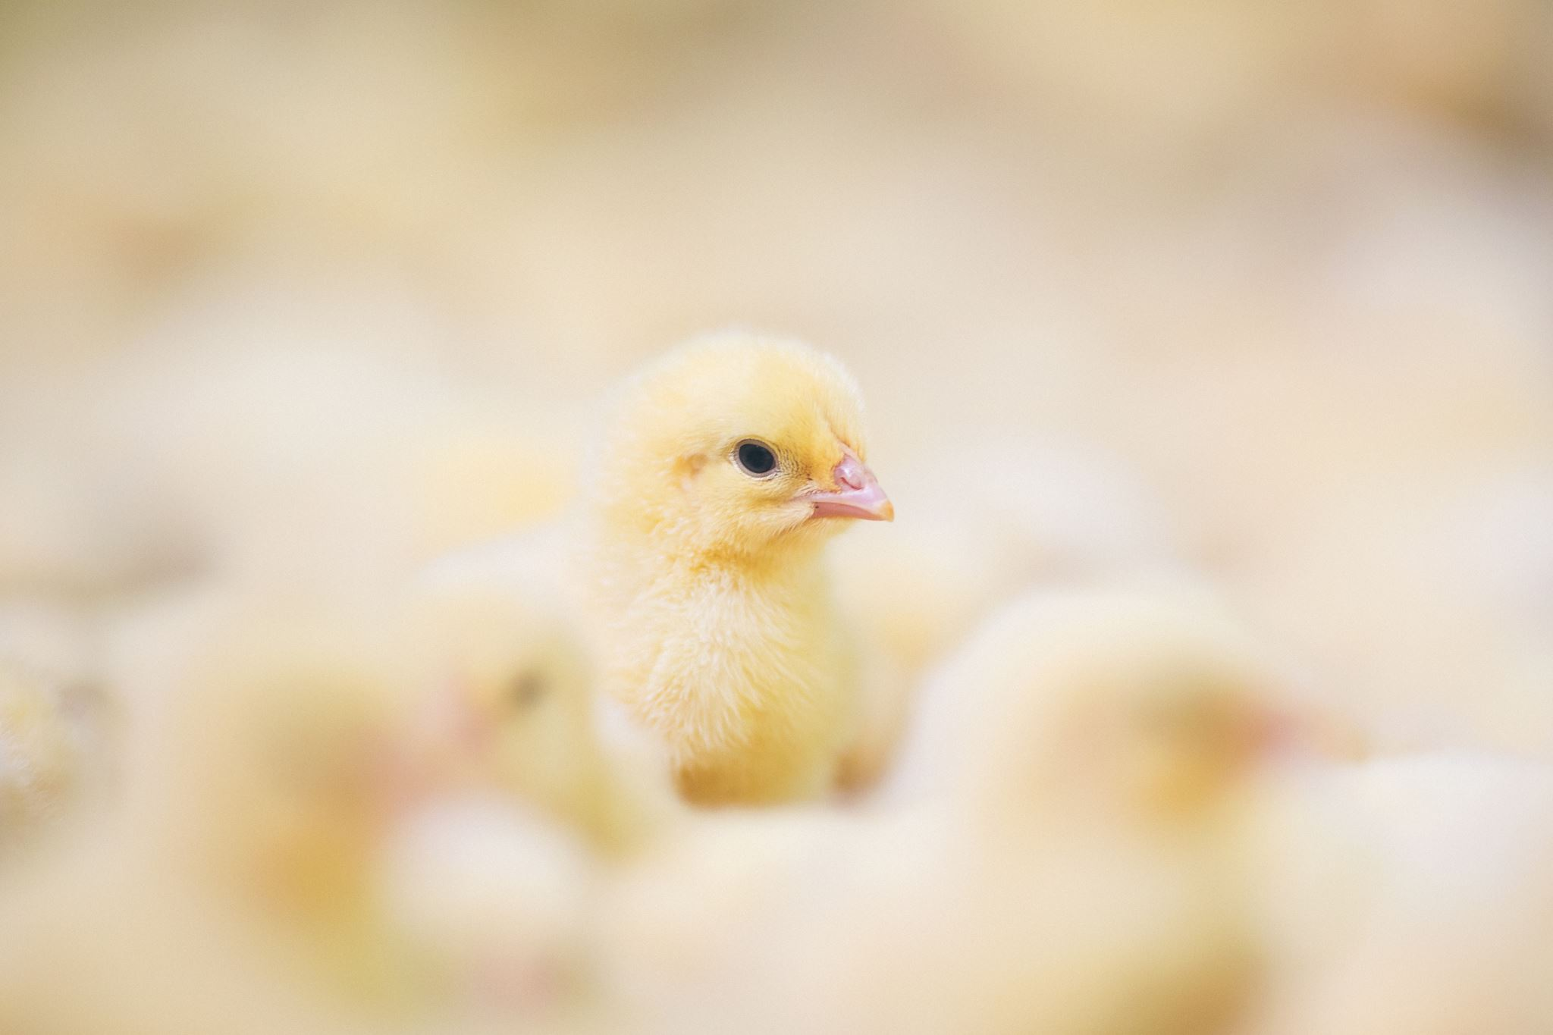

AutoMeet++ Infinity: A Multimodal Hybrid Audio Meeting Summarization System
(Paper id : 625)
Soma Chatterjee, Sohini Paul, Souparna Paul, Jaytanu Kundu, Shantanu Adhikary, Arijit Halder, Prithwi Rudra
Presented By
Souparna Paul Department of Computer Science and Engineering, Narula Institute of Technology

Slide 2
Outline
Introduction
Literature Survey
Motivation
Contribution
Methodology
Result and Discussion
Conclusion
References

Slide 3
Understanding Meeting Summarization
What is Meeting Summarization?
It is the process of automatically condensing a multi-party conversational transcript into a shorter version while retaining key information, decisions, and action items.
The Goal: Transforming hours of unstructured audio/video dialogue into a concise, readable text format.
Why is it Needed?
Information Overload: A typical 1-hour meeting generates ~10,000 words. Manually reviewing this for insights is inefficient.
Enhanced Productivity: Allows stakeholders who missed a session to catch up in minutes rather than hours.
Accountability: Provides a definitive record of "Who," "What," and "When" regarding task assignments.
Knowledge Retrieval: Converts transient speech into a permanent, searchable organizational asset.

Slide 4
Introduction: The Current Landscape
The Digital Surge: Exponential growth in virtual conferencing (Zoom, Teams) has led to massive amounts of unstructured conversational data [2, 23].
The Challenge: While we record more meetings than ever, our ability to synthesize them manually is declining due to time constraints and human subjectivity [2, 20]. Traditional note-taking fails to capture technical nuances [27].
Technical Hurdles: Existing automated systems often fail due to:
Noisy Data: Overlapping speech, background noise, and informal jargon.
Architecture Limits: Standard Transformers cannot process long transcripts (the "Token Limit" problem) [5, 19].
Hallucinations: Generative models often invent facts that were never discussed.
Solution: A modular system designed to solve these hurdles using a hybrid pipeline of Whisper (ASR), BERT (Extraction), and Pegasus (Refinement) [18, 22, 25].

Slide 5
Literature Survey
Research Area | Key Works / Authors | Core Approach | Limitations
Traditional Extractive | TextRank, LexRank | Graph-based ranking of sentences. | Lacks linguistic flow; ignores context.
Pure Abstractive | BART (Lewis et al.), T5 (Raffel et al.) | Encoder-Decoder Transformers. | High risk of "hallucinations" (fictional facts).
Long-Form Processing | Longformer (Beltagy et al.) | Sparse attention mechanisms. | High computational cost for very long meetings.
Hybrid SOTA | MatchSum (Zhong et al.) | Semantic matching of summaries. | Struggles with raw audio noise and accents.
Key Insights from Survey:
The "Context Wall": Most current models fail when meeting transcripts exceed 1024 tokens.
The Modality Gap: Most research focuses on text-to-text; few systems integrate high-accuracy ASR (like Whisper) directly into a hybrid summarization pipeline.
Factual Drift: Purely abstractive models often lose technical details crucial in corporate/technical meetings.

Slide 6
Literature Survey
Evolution: Summarization moved from statistical methods to deep learning paradigms [2, 3, 30].
Contextual Embeddings: Transformers [8] and BERT [9] revolutionized the field. Recent studies optimize BERT via mean pooling and freezing strategies [11, 12].
Abstractive Models: Pegasus is highly effective due to its Gap-Sentence Generation (GSG) pre-training objective [25].
Multimodal Shift: Integration of Whisper [18] allows systems to handle noisy real-world audio, a major step up from text-only models [13, 16, 17].

Slide 7
Identifying the Gap
Existing Limitation 1: Inability to handle "infinite" input lengths without losing the beginning or end of the conversation (The "Lost in the Middle" problem).
Existing Limitation 2: High word error rates (WER) in standard ASR systems when dealing with diverse accents or noisy environments.
Our Solution (AutoMeet++ Infinity): Bridges these gaps by combining Whisper’s robust ASR, Semantic Windowing for infinite length, and a Hybrid BERT-Pegasus pipeline to ensure both factual grounding and human-like flow.

Slide 8
Motivation
Noisy Transcripts: Real-world meetings contain filler words, overlapping speech, and informal jargon.
Token Limits: Most Transformer models (like BERT/Pegasus) struggle with long transcripts due to fixed input limits (512–1024 tokens).
The "Hallucination" Risk: Purely abstractive models often "invent" facts; purely extractive models lack flow.
Multimodal Need: Requirement for a system that handles Text, Audio, and Video seamlessly.

Slide 9
Contribution
Hybrid Architecture: Combines BERT (Extractive) for factual grounding and Pegasus (Abstractive) for linguistic fluency.
Whisper Integration: Robust Automatic Speech Recognition (ASR) to handle various accents and background noise.
Infinity Chunking: A novel overlapping window approach to bypass token limits, allowing the summarization of meetings of "infinite" length.
Factual Fidelity: Maintains a high semantic alignment.

Slide 10
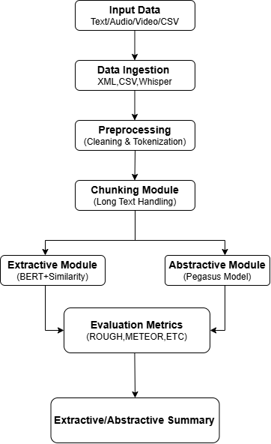
Methodology: Data Processing & ASR
Multimodal Input Handling: Supports raw audio (MP3/WAV), video (MP4), and structured text (CSV/TXT) [18].
High-Fidelity Transcription (OpenAI Whisper):
Utilizes a Transformer-based ASR model.
Chosen for its robustness against "Real-world" noise (accents, background chatter, and technical jargon).
Feature Extraction:
Audio is converted into log-Mel spectrograms.
Encoder-Decoder architecture maps audio features to a sequence of tokens, effectively handling the "noisy" nature of spontaneous conversation.

Slide 11
Methodology: Semantic Chunking & Hybrid Model
Infinity Semantic Chunking:
Problem: Standard Transformers have a 512–1024 token limit.
Solution: Implemented Overlapping Windowing. We split transcripts into chunks with a 10-20% overlap to ensure no context is lost at the "seams" of the chunks [15, 16, 20].
Extractive Layer (BERT):
Uses Mean Pooling of hidden states to generate sentence embeddings.
Calculates Cosine Similarity to identify "Centrality"—the most informative sentences are kept, while filler words and "small talk" are discarded [22].
Abstractive Refinement (Pegasus):
The extracted "key sentences" are fed into Pegasus.
Uses Gap-sentence Generation (GSG) pre-training logic to rewrite technical points into a cohesive, human-readable summary [8,25].
Fusion Logic:
The final output is a result of Sequential Refinement (Raw → Extracted → Abstracted).

Slide 12
The Hybrid Pipeline
Extractive (BERT):
Acts as a "Content Filter.“
Uses Mean Pooling & Cosine Similarity.
Ranks sentences based on centrality to the meeting context.
Abstractive (Pegasus):
Acts as a "Refinement Engine.“
Uses Beam Search & Length Penalties.
Generates coherent, human-like summaries from the extractive output.

Slide 13
Dataset & Experimentation
Dataset: Meta Kaggle Meeting Transcripts (Data Science discussions) [1].
Sample Size: 5,891 samples utilized for training/fine-tuning.
Test Set: 50 manually curated samples with ground-truth extractive and abstractive references.
Hardware: GPU-accelerated processing via PyTorch.

Slide 14
Results – Extractive Evaluation
Table 1: Extractive Model Performance
Table 2: Semantic Metrics (Extractive)
Metric | Precision | Recall | F1-Score
ROUGE-1 | 0.7032 | 0.6547 | 0.7253
ROUGE-2 | 0.6553 | 0.7240 | 0.7401
ROUGE-L | 0.7050 | 0.7426 | 0.7457
Metric | Score
METEOR | 0.7782
BERTScore (F1) | 0.7267

Slide 15
Results – Abstractive & Hybrid Evaluation
Table 3: Abstractive Model Performance
Table 4: Final Semantic and Linguistic Metrics
Metric | Precision | Recall | F1-Score
ROUGE-1 | 0.3490 | 0.3811 | 0.3360
ROUGE-2 | 0.1503 | 0.1611 | 0.1432
ROUGE-L | 0.2727 | 0.3040 | 0.2651
Metric | Score
METEOR | 0.2909
BERTScore (F1) | 0.8590

Slide 16
Comparative Accuracy Analysis
Table 5: Extractive Comparison (ROUGE-L F1)
Table 6: Hybrid/Abstractive Comparison (ROUGE-L F1)
Model | Score
AutoMeet++ (Proposed) | 0.7457
MatchSum (Latest) | 0.7159
TextRank (Recent) | 0.2537
Lead-100 Baseline | 0.2349
Model | Score
AutoMeet++ (Fine-tuned Pegasus) | 0.2651
FLAN-T5-Large (Latest) | 0.2492
BART-Large (Recent) | 0.2412
Pegasus-Base (Baseline) | 0.2253

Slide 17
Performance Evaluation
Extractive F1-Score (ROUGE-L): 0.7457 (High retention of facts).
Abstractive F1-Score (ROUGE-1): 0.3360.
Semantic Integrity (BERTScore): 0.8590 (Indicates very high contextual similarity to human summaries).
METEOR Score: 0.2909.

Slide 18
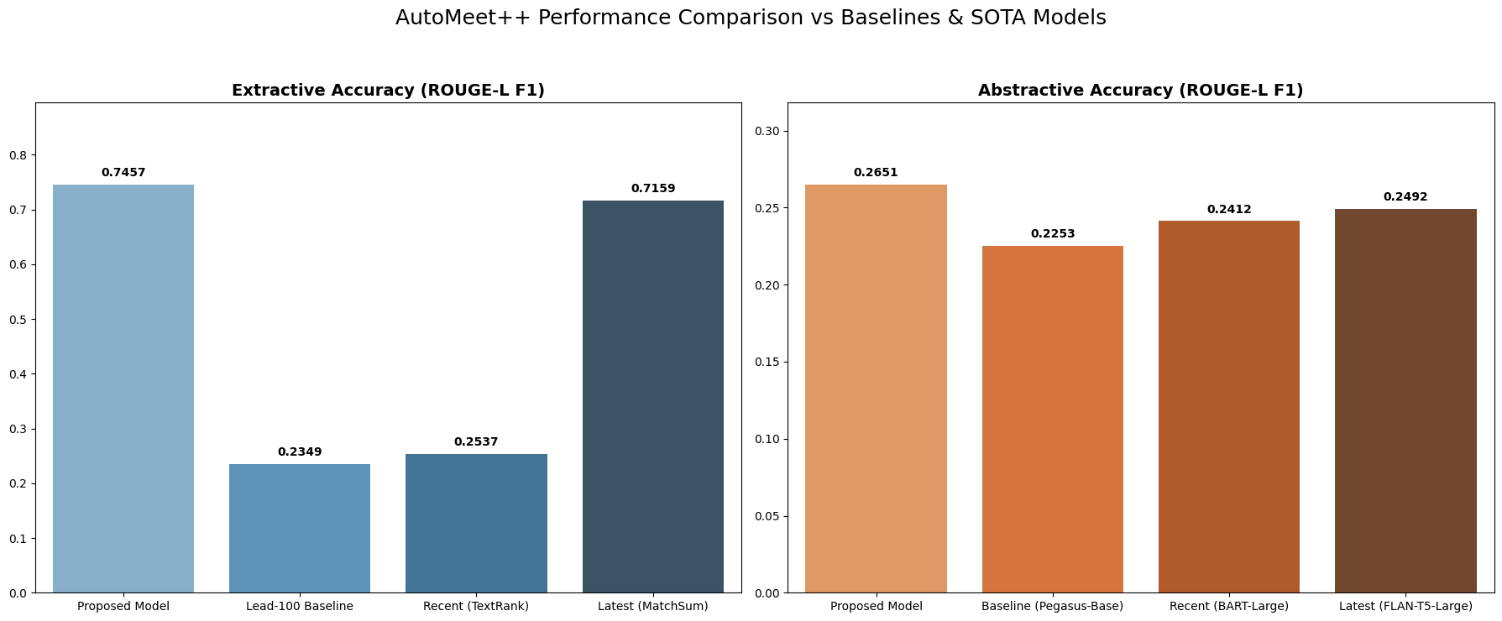
Comparative Analysis
Key Takeaways:
Outperforms MatchSum (Latest) in extractive accuracy.
Superior to FLAN-T5-Large and BART-Large in abstractive fluency.
Significant improvement over traditional baselines like TextRank and Lead-100.

Slide 19
Scalability & Discussion
Unlimited Length: Overlapping chunking ensures the system doesn't crash on long board meetings.
Domain Generalization: Successfully handles technical data science jargon and informal community chat.
Efficiency: Uses model distillation techniques (Whisper Base) to balance speed and accuracy.

Slide 20
Conclusion & Future Work
Conclusion: AutoMeet++ Infinity successfully bridges the gap between raw audio and high-quality summaries using a hybrid approach.
Future Work:
Real-time deployment for live meeting captions and summaries.
Model quantization for use on low-resource mobile devices.
Speaker diarization (identifying who said what).

Slide 21
References
[1] Kowald, D., et al. "Using the Open Meta Kaggle Dataset," 2019.
[2] Zhang, H., et al. "A Systematic Survey of Text Summarization," 2025.
[3] Azam, M., et al. "Current Trends in Extractive Text Summarization," 2025.
[4] Giarelis, N., et al. "Abstractive vs. Extractive Summarization," 2023.
[5] Zhang, M., et al. "Survey of Abstractive Text Summarization," 2022.
[6] Gulati, V., et al. "Extractive Article Summarization using TextRank," 2023.
[7] Yulianti, E., et al. "Enhanced TextRank using weighted word embedding," 2023.
[8] Vaswani, A., et al. "Attention Is All You Need," 2017.
[9] Devlin, J., et al. "BERT: Pre-training of Deep Bidirectional Transformers," 2019.
[10] Jiang, T., et al. "PromptBERT: Improving BERT Sentence Embeddings," 2022.
[11] Galal, O., et al. "Rethinking of BERT sentence embedding," 2024.
[12] Stankevičius, L., et al. "Extracting Sentence Embeddings from Transformers," 2024.
[13] Mogul, N., et al. "Summarizing Team Meetings," 2022.
[14] Prasanna Kumar, L., et al. "Meeting Summarization: A Survey," 2022.
[15] Rennard, V., et al. "Abstractive Meeting Summarization: A Survey," 2023.
[16] Laskar, M.T.R., et al. "Building Real-World Meeting Summarization Systems," 2023.

Slide 22
References
[17] Agrawal, P., et al. "Speech-to-Text Conversion and Text Summarization," 2024.
[18] Wilkey, M., et al. "Transcription of Audio and Video with OpenAI's Whisper," 2026.
[19] Kirstein, F., et al. "CADS: Literature Review on Abstractive Dialogue Summarization," 2025.
[20] Hu, Y., et al. "MeetingBank: A Benchmark Dataset," 2023.
[21] Wang, Y., et al. "Improving extractive summarization with topic-injection BERT," 2024.
[22] Abdel-Salam, S., et al. "Performance Study on Extractive Text Summarization," 2022.
[23] Jia, Q., et al. "Taxonomy of Abstractive Dialogue Summarization," 2023.
[24] Aggarwal, R., et al. "Conversational Summarization and Response Generation," 2025.
[25] Benny, A. "Text Summarization using Pegasus Model," 2024.
[26] Junadhi, et al. "Improving Evaluation Metrics for Text Summarization," 2025.
[27] Rajesh, P. "Machine learning techniques like SVMs for extractive summaries," 2025.
[28] Daraghmi, E., et al. "A Comparative Study of PEGASUS, BART, and T5," 2025.
[29] Fu, X. "Transformer models in text summarization," 2024.
[30] Nnadi, G.O., et al. "Survey on Abstractive Text Summarization," 2024.
[31] Dharrao, D., et al. "Summarizing Business News: Evaluating BART, T5, and PEGASUS," 2024.
[32] Zayed, S., et al. "An Enhanced Transformer–Extractive Hybrid Model," 2026.

Slide 23
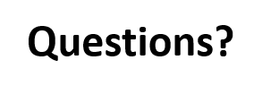
Thank You!
Contact: souparnopaulreborn@gmail.com / somadey05@gmail.com
Institution: Narula Institute of Technology / RCCIIT

